Slide 1
Singleton

Slide 2
What is?
Class has only one instance(object), while providing a global access point to this instance
The object is created once

Slide 3
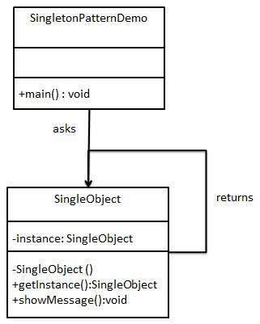
Implementation

